Slide 1

Neural Networks
BI Tech Surgery | Nov 16th 2018 | Ankush Tale
Notes:
I wanted to talk a session on LSTMs and how they can be applied in Sentiment Analysis
Sessions on fundamentals. We won’t be covering this in future and would only focus on Applications which is what is expected from Tech Surgery Sessions.

Slide 2

Topics to cover
What is a Biological Neuron?
What is a Artificial Neuron?
A Perceptron
Example of a binary function
Activation Function
Loss function
Loss optimization methods
Example of classification using Neural Net
Acknowledgement:
Content from IITM CS7015 – Deep Learning by Prof. Mitesh Khapra
Notes:
Disclaimer for simplicity,
You are here cz you want to learn about ML, it is heavily based on maths. These slides are slightly based on maths,
If you don’t get it ask, or else go with the flow and we’ll revise in the end

Slide 3
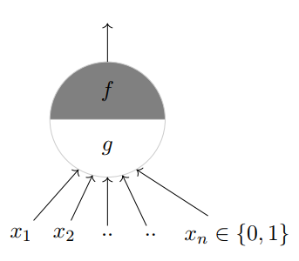
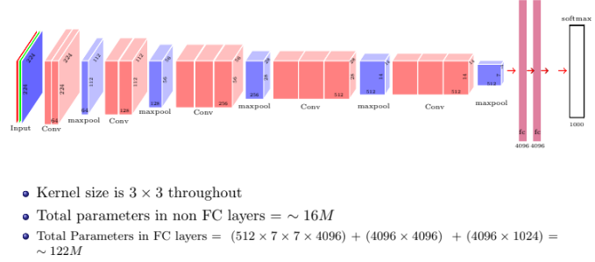
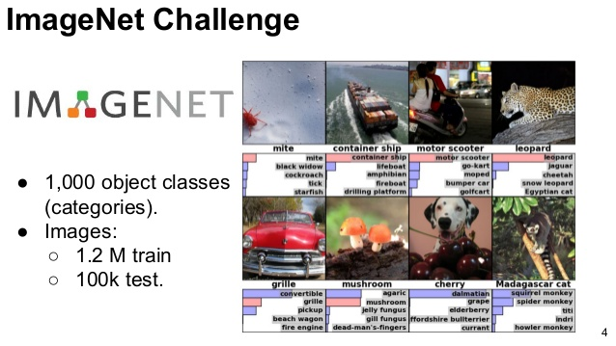
Journey
Applies a function
Sums up inputs
Notes:
Simple Neuron to VGGNet Arch(2014)

Slide 4

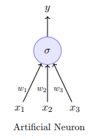
Artificial Neuron
Fundamental unit of a neural network
Inspired from biological Neurons

Slide 5
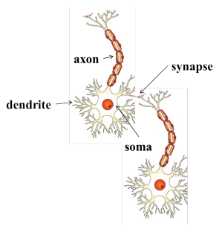
Biological Neuron
Neuron proposed 1891, Synapse in 1950
Dendrite: receives signals from other neurons
Synapse: point of connection to other neurons
Soma: processes the information
Axon: transmits the output of this neuron

Slide 6
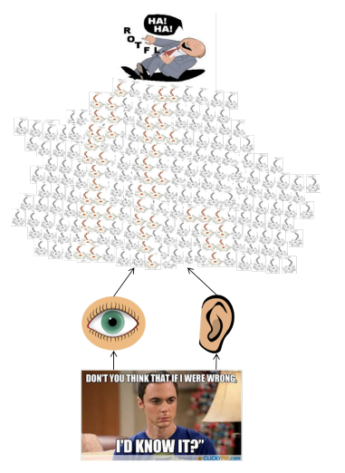
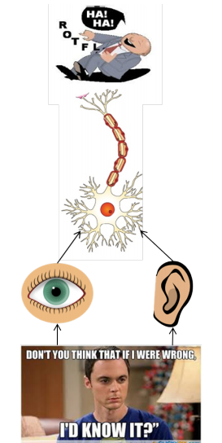
How do Neuron’s work
Our sense organs interact with the outside world
They relay information to the neurons
The neurons (may) get activated and produces a response
Of course in reality it is a massively parallel interconnected network of neurons
An average human brain has around 10¹¹ (100 billion) neurons!
Notes:
Example of a pothole while driving a bike

Slide 7
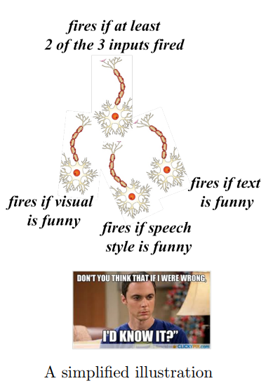

How do Neuron’s work
This massively parallel network also ensures that there is division of work
Each neuron may perform a certain role or respond to a certain stimulus
Distributed representation
Best visualization available at
https://distill.pub/2018/building-blocks/
Notes:
Example of memes

Slide 8
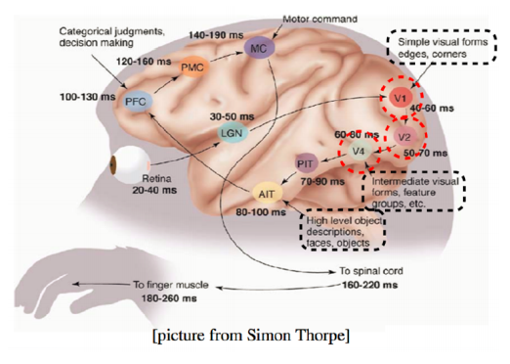

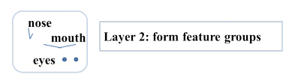
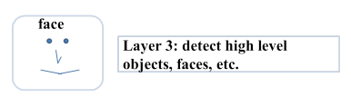
How do Neuron’s work
Notes:
Some neuron fire for edges, some of them can fire for corners too.

Slide 9

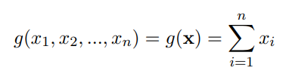
McCulloch & Pits Neuron
McCulloch (neuroscientist) and Pitts (logician) proposed a highly simplified computational model of the neuron (1943)
some number
Weight w0
Applies a function
Sums up inputs
Notes:
We’ll start with simple and abstract concepts and gradually move towards complex, real life ones
There’s a famous quote that says with every formula a presenter shows, he/she looses half his audience. Let me be brave enough to lose half of you.

Slide 10
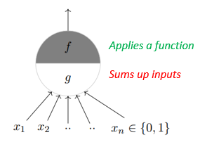
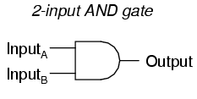
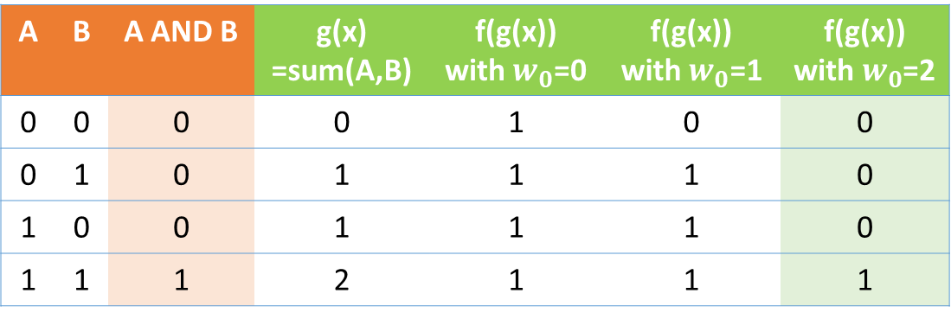
McCulloch & Pits Neuron
Input: 2 bit binary
Output expected: AND Gate
For 2 binary inputs,
We wish to build a Neuron
That gives output similar to AND
Weight=?
Expected
Predicted
Predicted
Predicted
A | B | A AND B | g(x) =sum(A,B) | f(g(x)) with${ w}_{0}$=0 | f(g(x)) with${ w}_{0}$=1 | f(g(x)) with $w_{0}$=2
0 | 0 | 0 | 0 | 1 | 0 | 0
0 | 1 | 0 | 1 | 1 | 1 | 0
1 | 0 | 0 | 1 | 1 | 1 | 0
1 | 1 | 1 | 2 | 1 | 1 | 1
Notes:
Remember the And function, you might have seen this in high school or college depending on if you went to CBSE or SSC

Slide 11
McCulloch & Pits Neuron
Weight=?
A | B | A AND B | g(x) =sum(A,B) | f(g(x)) with${ w}_{0}$=0 | f(g(x)) with${ w}_{0}$=1 | f(g(x)) with $w_{0}$=2
0 | 0 | 0 | 0 | 1 | 0 | 0
0 | 1 | 0 | 1 | 1 | 1 | 0
1 | 0 | 0 | 1 | 1 | 1 | 0
1 | 1 | 1 | 2 | 1 | 1 | 1

Slide 12
McCulloch & Pits Neuron
Weight=?
For different values of weights
A | B | A AND B | g(x) =sum(A,B) | f(g(x)) with${ w}_{0}$=0 | f(g(x)) with${ w}_{0}$=1 | f(g(x)) with $w_{0}$=2
0 | 0 | 0 | 0 | 1 | 0 | 0
0 | 1 | 0 | 1 | 1 | 1 | 0
1 | 0 | 0 | 1 | 1 | 1 | 0
1 | 1 | 1 | 2 | 1 | 1 | 1

Slide 13
McCulloch & Pits Neuron
To predict output same as AND,
Weight = 2
Weight=2
A | B | A AND B | g(x) =sum(A,B) | f(g(x)) with${ w}_{0}$=0 | f(g(x)) with${ w}_{0}$=1 | f(g(x)) with $w_{0}$=2
0 | 0 | 0 | 0 | 1 | 0 | 0
0 | 1 | 0 | 1 | 1 | 1 | 0
1 | 0 | 0 | 1 | 1 | 1 | 0
1 | 1 | 1 | 2 | 1 | 1 | 1

Slide 14
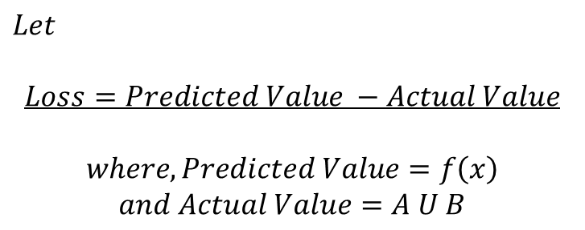
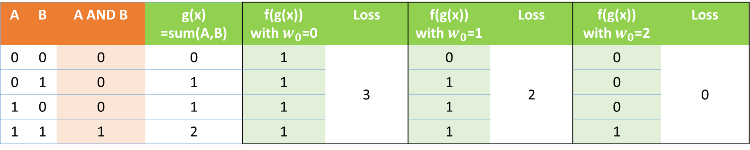
McCulloch & Pits Neuron
$$Let$$
$$Loss=Predicted Value −Actual Value$$
$$where, Predicted Value=f\left(x\right)$$
$$and Actual Value=A U B$$
A | B | A AND B | g(x) =sum(A,B) | f(g(x)) with${ w}_{0}$=0 | Loss | f(g(x)) with${ w}_{0}$=1 | Loss | f(g(x)) with${ w}_{0}$=2 | Loss
0 | 0 | 0 | 0 | 1 | 3 | 0 | 2 | 0 | 0
0 | 1 | 0 | 1 | 1 |  | 1 |  | 0
1 | 0 | 0 | 1 | 1 |  | 1 |  | 0
1 | 1 | 1 | 2 | 1 |  | 1 |  | 1

Slide 15
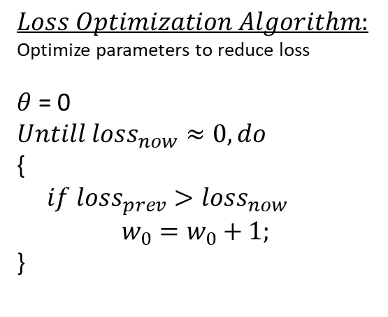
McCulloch & Pits Neuron
$$Loss Optimization Algorithm:$$
Optimize parameters to reduce loss
$θ$ = 0
$$Untill loss_{now}≈0, do$$
{
$if loss_{prev}>loss_{now}$
$w_{0}=w_{0}+1;$
}
A | B | A AND B | g(x) =sum(A,B) | f(g(x)) with${ w}_{0}$=0 | Loss | f(g(x)) with${ w}_{0}$=1 | Loss | f(g(x)) with${ w}_{0}$=2 | Loss
0 | 0 | 0 | 0 | 1 | 3 | 0 | 2 | 0 | 0
0 | 1 | 0 | 1 | 1 |  | 1 |  | 0
1 | 0 | 0 | 1 | 1 |  | 1 |  | 0
1 | 1 | 1 | 2 | 1 |  | 1 |  | 1

Slide 16

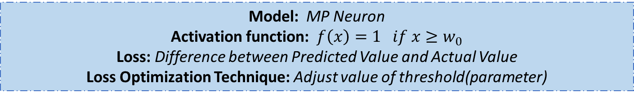
So, given an input, we need to find a function that fits the input.
This is what Machine Learning is all about ☺
Congratulations! You understood your very first ML model (proposed way back in 1943)
Model: MP Neuron
Activation function: $f\left(x\right)=1 if x≥w_{0}$
Loss: Difference between Predicted Value and Actual Value
Loss Optimization Technique: Adjust value of threshold(parameter)
Notes:
Timeline of evolution of algos in ML; everything you see today started after 2006; not exactly activation function but let’s go with it as of now.

Slide 17
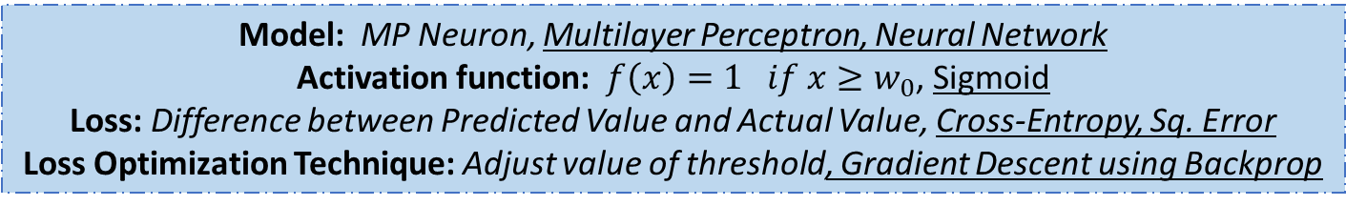
So, given an input, we need to find a function that fits the input.
This is what Machine Learning is all about ☺
Congratulations! You understood your very first ML model (proposed way back in 1943)
Model: MP Neuron, Multilayer Perceptron, Neural Network
Activation function: $f\left(x\right)=1 if x≥w_{0}$, Sigmoid
Loss: Difference between Predicted Value and Actual Value, Cross-Entropy, Sq. Error
Loss Optimization Technique: Adjust value of threshold, Gradient Descent using Backprop
Notes:
We’ll cover these too today; Expertise is knowing what to use when and why; Functions readily available

Slide 18
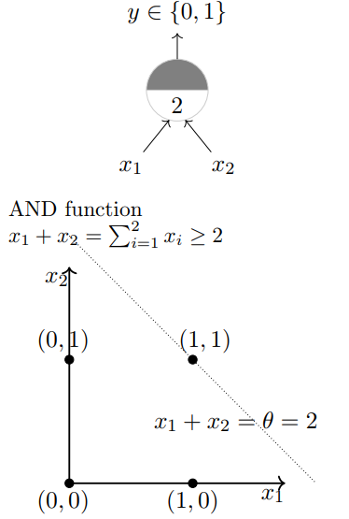
Visualize Boundary condition
Boundary condition is the point/line/plane beyond which your output changes i.e. from 0 to 1
Equation of line
Notes:
On case of OR

Slide 19
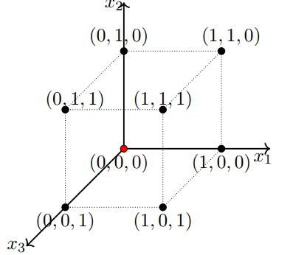
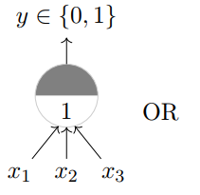
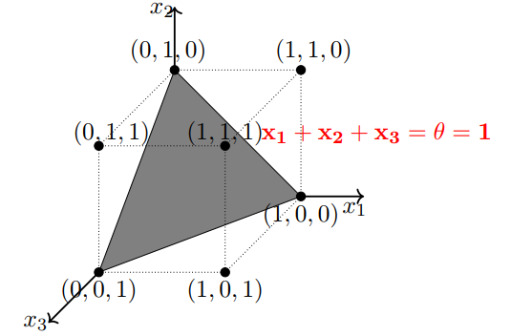
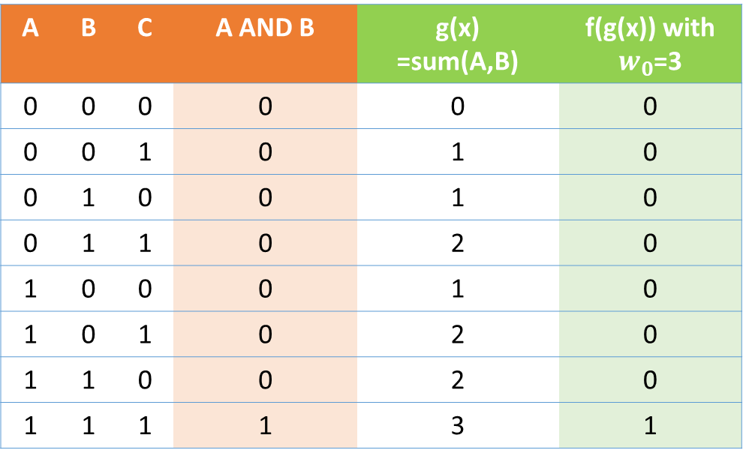
For 3 inputs
A | B | C | A AND B | g(x) =sum(A,B) | f(g(x)) with $w_{0}$=3
0 | 0 | 0 | 0 | 0 | 0
0 | 0 | 1 | 0 | 1 | 0
0 | 1 | 0 | 0 | 1 | 0
0 | 1 | 1 | 0 | 2 | 0
1 | 0 | 0 | 0 | 1 | 0
1 | 0 | 1 | 0 | 2 | 0
1 | 1 | 0 | 0 | 2 | 0
1 | 1 | 1 | 1 | 3 | 1

Slide 20

Changing Gears - Model Equation
Until now:
$$y_{1}=x_{1}+x_{2}≥w_{0}$$
Now on:
$$y_{1}=w_{1}x_{1}+w_{2}x_{2}≥w_{0}$$
$=w_{1}x_{1}+w_{2}x_{2}−w_{0}≥0$
$={w_{0}x_{0}+w}_{1}x_{1}+w_{2}x_{2}≥0 where x_{0}=−1$

Slide 21
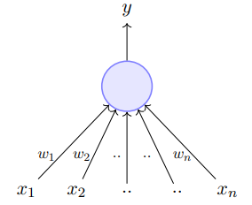
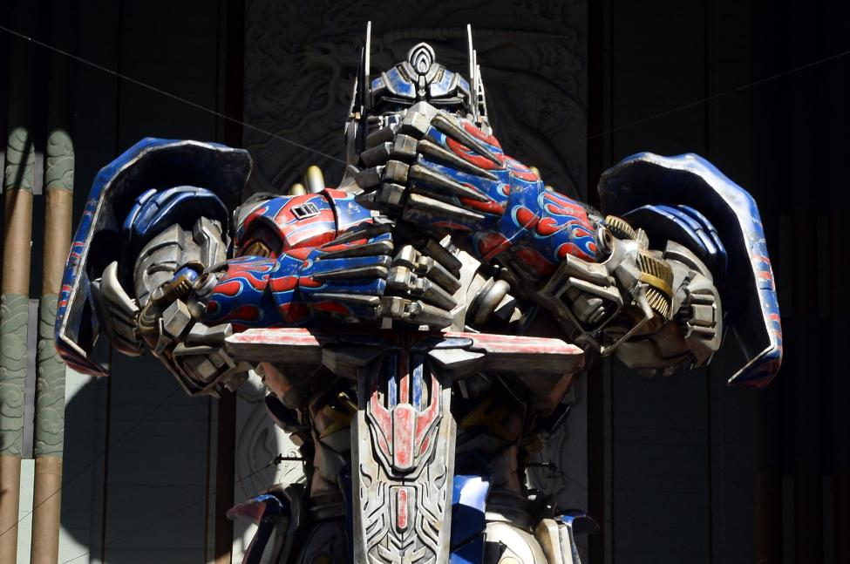
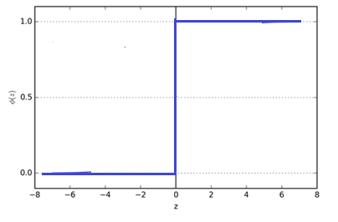
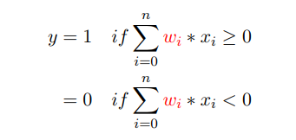
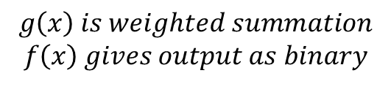
Perceptron
f
g
For non-Boolean, real value, not linearly separable inputs (1958)
$$g\left(x\right) is weighted summation$$
$$f\left(x\right) gives output as binary$$
Notes:
Now we’ll see a new model

Slide 22
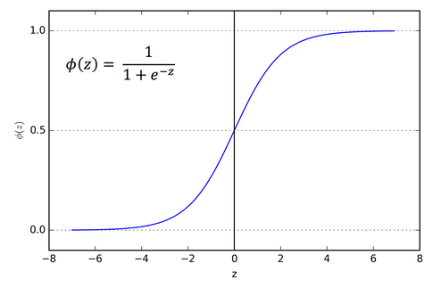
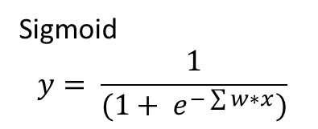
Another Activation function
If you want output in range of 0 to 1, use Sigmoid function as activation function
Sigmoid
$$y= \frac{1}{(1+ e^{−\sum{w∗x}})}$$

Slide 23
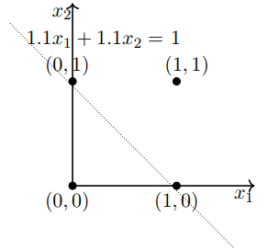
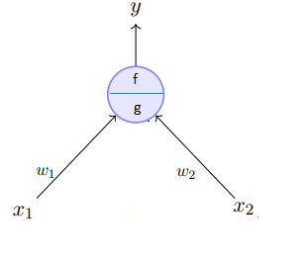
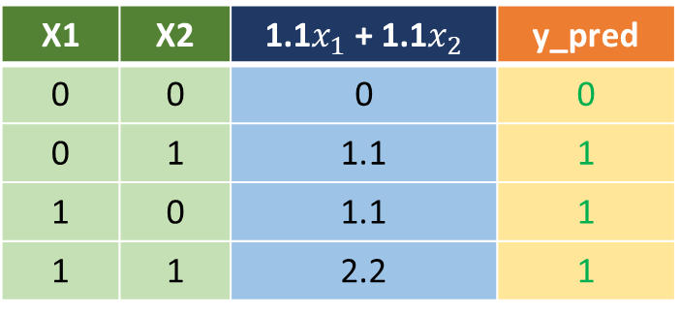
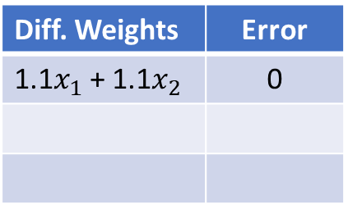

Boolean functions with Perceptron
Remember, the only addition in
MP Neuron model is the weights
Let’s implement the OR function
$$y=1 if w_{1}x_{1}+w_{2}x_{2}≥w_{0}$$
X1 | X2 | 1.1$x_{1}$ + 1.1$x_{2}$ | y_pred
0 | 0 | 0 | 0
0 | 1 | 1.1 | 1
1 | 0 | 1.1 | 1
1 | 1 | 2.2 | 1
Diff. Weights | Error
1.1$x_{1}$ + 1.1$x_{2}$ | 0

Slide 24
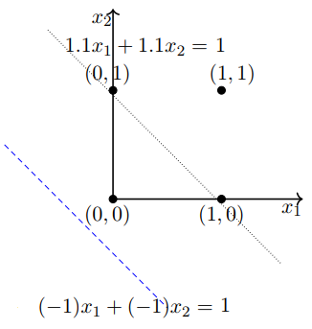
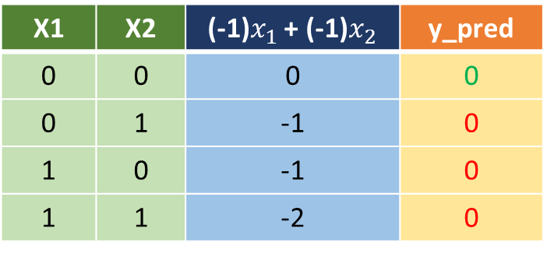
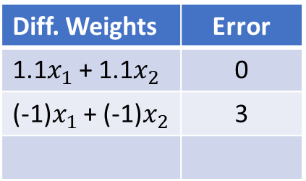
Boolean functions with Perceptron
Remember, the only addition in
MP Neuron model is the weights
Let’s implement the OR function
$$y=1 if w_{1}x_{1}+w_{2}x_{2}≥w_{0}$$
X1 | X2 | (-1)$x_{1}$ + (-1)$x_{2}$ | y_pred
0 | 0 | 0 | 0
0 | 1 | -1 | 0
1 | 0 | -1 | 0
1 | 1 | -2 | 0
Diff. Weights | Error
1.1$x_{1}$ + 1.1$x_{2}$ | 0
(-1)$x_{1}$ + (-1)$x_{2}$ | 3

Slide 25
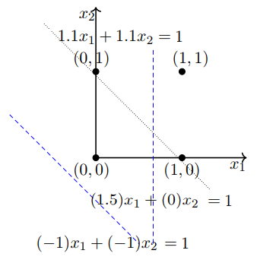
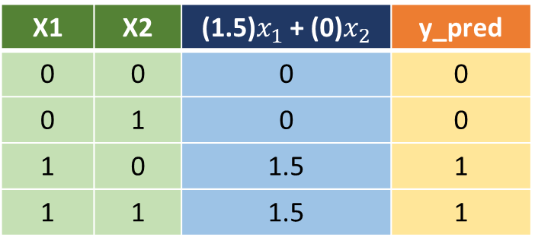
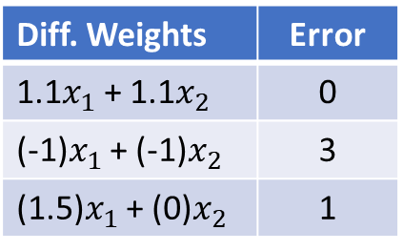
Boolean functions with Perceptron
Remember, the only addition in
MP Neuron model is the weights
Let’s implement the OR function
$$y=1 if w_{1}x_{1}+w_{2}x_{2}≥w_{0}$$
X1 | X2 | (1.5)$x_{1}$ + (0)$x_{2}$ | y_pred
0 | 0 | 0 | 0
0 | 1 | 0 | 0
1 | 0 | 1.5 | 1
1 | 1 | 1.5 | 1
Diff. Weights | Error
1.1$x_{1}$ + 1.1$x_{2}$ | 0
(-1)$x_{1}$ + (-1)$x_{2}$ | 3
(1.5)$x_{1}$ + (0)$x_{2}$ | 1

Slide 26
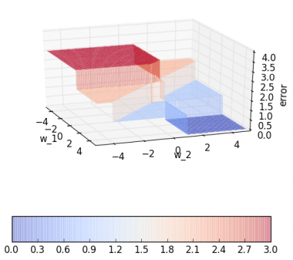
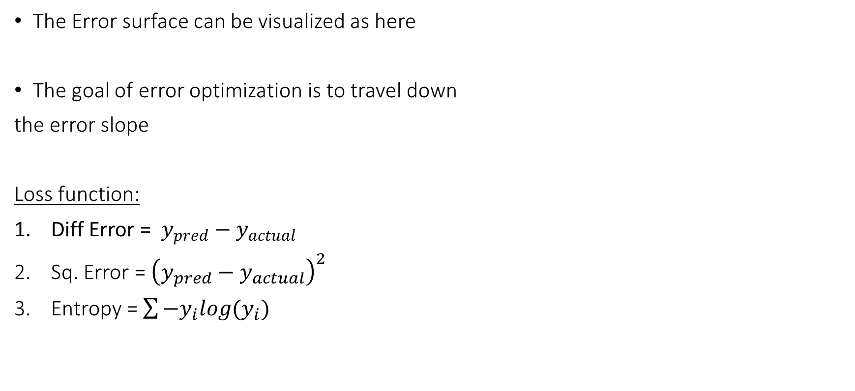
Error Surfaces
The Error surface can be visualized as here
The goal of error optimization is to travel down
the error slope
Loss function:
Diff Error = $y_{pred}−y_{actual}$
Sq. Error = ${\left(y_{pred}−y_{actual}\right)}^{2}$
Entropy = $\sum{−y_{i}log{(y}_{i})}$

Slide 27
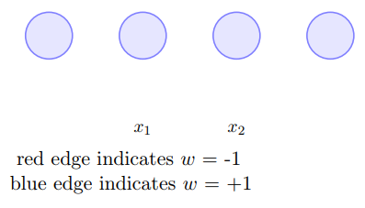
Multi-Layer Perceptron
Notes:
Sounds like a Autobot from Transformers

Slide 28
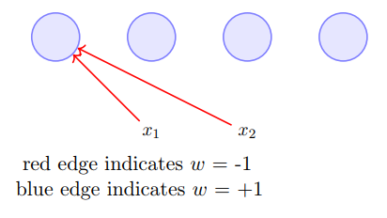

Multi-Layer Perceptron
$$a_{1}= (−1)∗x_{1}+\left(−1\right)∗x_{2}$$
Notes:
Sounds like a Autobot from Transformers

Slide 29
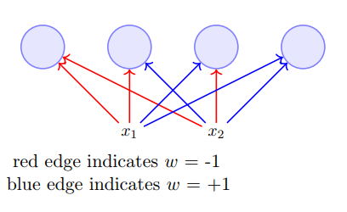



Multi-Layer Perceptron
$$a_{1}= (−1)∗x_{1}+\left(−1\right)∗x_{2}$$
$$a_{2}= (−1)∗x_{1}+\left(1\right)∗x_{2}$$
$$a_{3}= (1)∗x_{1}+\left(−1\right)∗x_{2}$$
$$a_{4}= (1)∗x_{1}+\left(1\right)∗x_{2}$$
Notes:
Sounds like a Autobot from Transformers

Slide 30
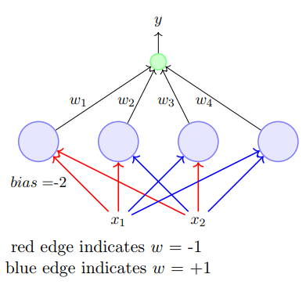
Multi-Layer Perceptron
$$y=w_{1}∗a_{1}+w_{2}∗x_{2}+w_{3}∗a_{3}+w_{4}∗a_{4}$$
$$a_{1}= (−1)∗x_{1}+\left(−1\right)∗x_{2}$$
$$a_{2}= (−1)∗x_{1}+\left(1\right)∗x_{2}$$
$$a_{3}= (1)∗x_{1}+\left(−1\right)∗x_{2}$$
$$a_{4}= (1)∗x_{1}+\left(1\right)∗x_{2}$$
Notes:
Sounds like a Autobot from Transformers

Slide 31
Multi-Layer Perceptron
The first layer is Input Layer
The last layer is Output Layer
There can be one or many hidden layers
I claim that this architecture can fit any Boolean function
Try it out!
Notes:
Sounds like a Autobot from Transformers

Slide 32
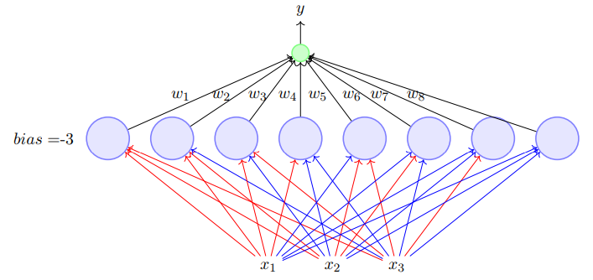
Multi-Layer Perceptron
Notes:
Sounds like a Autobot from Transformers

Slide 33
Neural Net
Notes:
For one input value only. For ex. (Padman) X1 = 1, X2 = 8.1, X3 = 10cr

Slide 34
Neural Net
Is_RadhikaApte_Actress
x₁
0/1
IMDB_rating
x₂
0-10
x₃
FirstDay_BoxOffice_Collection
Real Number
Notes:
For one input value only. For ex. (Padman) X1 = 1, X2 = 8.1, X3 = 10cr

Slide 35

Neural Net
$$a_{1}=sigmoid\left(w_{111}x_{1}+w_{112}x_{2}+w_{113}x_{3}\right)$$
Where sigmoid is
$$f(z)= \frac{1}{(1+ e^{−z})}$$
a₁
W₁₁₁ = 10
Is_RadhikaApte_Actress
x₁
0/1
W₁₁₂ = 7
W₁₁₃ = 3
IMDB_rating
x₂
0-10
x₃
FirstDay_BoxOffice_Collection
Real Number

Slide 36
Neural Net
Is_RadhikaApte_Actress
x₁
W₁₂₁ = 8
0/1
a₁
a₂
W₁₂₂ = 12
IMDB_rating
x₂
0-10
W₁₂₃ = 8
x₃
FirstDay_BoxOffice_Collection
Real Number

Slide 37

Neural Net
W₁ = $\begin{matrix}w_{111} & w_{112} & w_{113} \\ w_{121} & w_{122} & w_{123} \\ w_{131} & w_{132} & w_{133} \\ w_{141} & w_{142} & w_{143}\end{matrix}$
a₁
Is_RadhikaApte_Actress
x₁
0/1
a₂
IMDB_rating
x₂
0-10
a₃
x₃
FirstDay_BoxOffice_Collection
Real Number
a₄

Slide 38


Neural Net
W₁ = $\begin{matrix}w_{111} & w_{112} & w_{113} \\ w_{121} & w_{122} & w_{123} \\ w_{131} & w_{132} & w_{133} \\ w_{141} & w_{142} & w_{143}\end{matrix}$
W₂ =$\begin{matrix}w_{211} & w_{212} \\ w_{221} & w_{222} \\ w_{231} & w_{232} \\ w_{241} & w_{242}\end{matrix}$
a₁
$$y_{1}=sigmoid\left(\begin{aligned}w_{211}a_{1}+w_{212}a_{2} \\ +w_{213}a_{3}+w_{214}a_{4}\end{aligned}\right)$$
Is_RadhikaApte_Actress
x₁
0/1
a₂
y₁
WatchMovieInTheatre
0/1
IMDB_rating
x₂
0-10
a₃
y₂
WatchMovieOnNetflix
x₃
0/1
FirstDay_BoxOffice_Collection
Real Number
a₄
Notes:
Forward Propogation

Slide 39


Neural Network
Input Layer, Output Layer and multiple hidden layers
$$w_{ij} are weights, δ_{i} is sigmoid, a_{i} is activation, y_{i} is output$$
Dab of History:
Along with Backprop in 1986
Revived in 2006 with Unsupervised Pre-Training
2009 -> Hand-writing recognition
2012-16 -> ImageNet challenge
2015 -> Speech Recognition
2014 -> Seq-2-Seq Attention mechanism
2016 -> Deep Q-Network in Reinforcement Learning

Slide 40



Loss Optimization Algorithm
$$Loss Optimization Algorithm:$$
Optimize parameters to reduce loss
$θ$ = 0
$$Untill loss_{now}≈0, do$$
{
$if loss_{prev}>loss_{now}$
$θ=θ+1;$
}
Diff. Weights | Error
1.1$x_{1}$ + 1.1$x_{2}$ | 0
(-1)$x_{1}$ + (-1)$x_{2}$ | 3
(1.5)$x_{1}$ + (0)$x_{2}$ | 1
A | B | A AND B | g(x) =sum(A,B) | f(g(x)) with $θ$=0 | Loss | f(g(x)) with $θ$=1 | Loss | f(g(x)) with $θ$=2 | Loss
0 | 0 | 0 | 0 | 1 | 3 | 0 | 2 | 0 | 0
0 | 1 | 0 | 1 | 1 |  | 1 |  | 0
1 | 0 | 0 | 1 | 1 |  | 1 |  | 0
1 | 1 | 1 | 2 | 1 |  | 1 |  | 1

Slide 41

BackProp
W₁
W₂
a₁
$$Loss=Actual output$$
$$−Predicted output$$
Is_RadhikaApte_Actress
x₁
0/1
a₂
y₁
WatchMovieInTheatre
0/1
IMDB_rating
x₂
0-10
a₃
y₂
WatchMovieOnNetflix
x₃
0/1
FirstDay_BoxOffice_Collection
Real Number
a₄
Notes:
Back Propogation

Slide 42
BackProp
W₁
W_{2new} = W₂ - ∆
a₁
$$Loss=Actual output$$
$$−Predicted output$$
Is_RadhikaApte_Actress
x₁
0/1
a₂
y₁
WatchMovieInTheatre
0/1
IMDB_rating
x₂
0-10
a₃
y₂
WatchMovieOnNetflix
x₃
0/1
FirstDay_BoxOffice_Collection
Real Number
a₄
Notes:
Back Propogation

Slide 43
BackProp
W_{1new} = W₁ - ∆
W_{2new}
a₁
$$Loss=Actual output$$
$$−Predicted output$$
Is_RadhikaApte_Actress
x₁
0/1
a₂
y₁
WatchMovieInTheatre
0/1
IMDB_rating
x₂
0-10
a₃
y₂
WatchMovieOnNetflix
x₃
0/1
FirstDay_BoxOffice_Collection
Real Number
a₄
Notes:
Back Propogation

Slide 44
Neural Net Training Algorithm
Take Inputs
Initialize Weights/Parameters
For each input example
Do Forward Propagation and find predicted output
Calculate Loss for that example
Do Back Propagation and get new weights
Get trained model with right weights

Slide 45

Recap
Model: MP Neuron, Multilayer Perceptron, Neural Network
Activation function: $f\left(x\right)=1 if x≥ θ$, Sigmoid
Loss: Difference between Predicted Value and Actual Value, Cross-Entropy, Sq. Error
Loss Optimization Technique: Adjust value of threshold, Gradient Descent using Backprop

Slide 46


Demo time!
*NN Arch for MNIST explained well here

Slide 47

Thank you
Feedback much appreciated ☺
https://tinyurl.com/BITechSurgery
Presentation and code: https://github.com/ankushtale/
PyData November Meetup – Nov 25th

